Slide 1

SQL Copilot: Natural Language to SQL using Gemini
DATS 6312 — Applied Natural Language Processing
The George Washington University
Prof. Ning Rui
Shaik Mohammad Mujahid Khalandar • Ayush Meshram

Slide 2

Introduction: Bridging Natural Language and Databases
What is Natural Language to SQL?
Transforming everyday questions into structured database queries enables non-technical users to extract insights without learning SQL syntax. This democratizes data access across organizations.
Why SQL Copilot?
Traditional business intelligence tools require training and technical expertise. SQL Copilot removes this barrier by interpreting user intent and generating accurate SQL queries instantly.
Our Contribution
We leverage Google Gemini's advanced language understanding to create an accessible, accurate natural language interface for fossil fuel energy data analysis.

Slide 3

Dataset Description
Dataset Name
Key Features
Data Scale
fossil_trend_countries — annual fossil-energy share by country
Country, Year, Fossil Fuel Share (%), Energy Consumption, Carbon Emissions
Multi-year temporal data spanning multiple countries with detailed energy metrics
This structured environmental dataset enables complex analytical queries about global energy trends, making it ideal for testing natural language SQL generation capabilities.

Slide 4
NLP Model Architecture
Google Gemini: Advanced Language Understanding
Gemini Processing
Natural Language Input
LLM translates to SQL with schema context
User passes question in plain English
Results Display
Query Execution
Structured output with visualizations
SQLite processes the generated query
The system maintains schema awareness throughout the pipeline, ensuring generated queries are valid and semantically aligned with the underlying database structure.

Slide 5
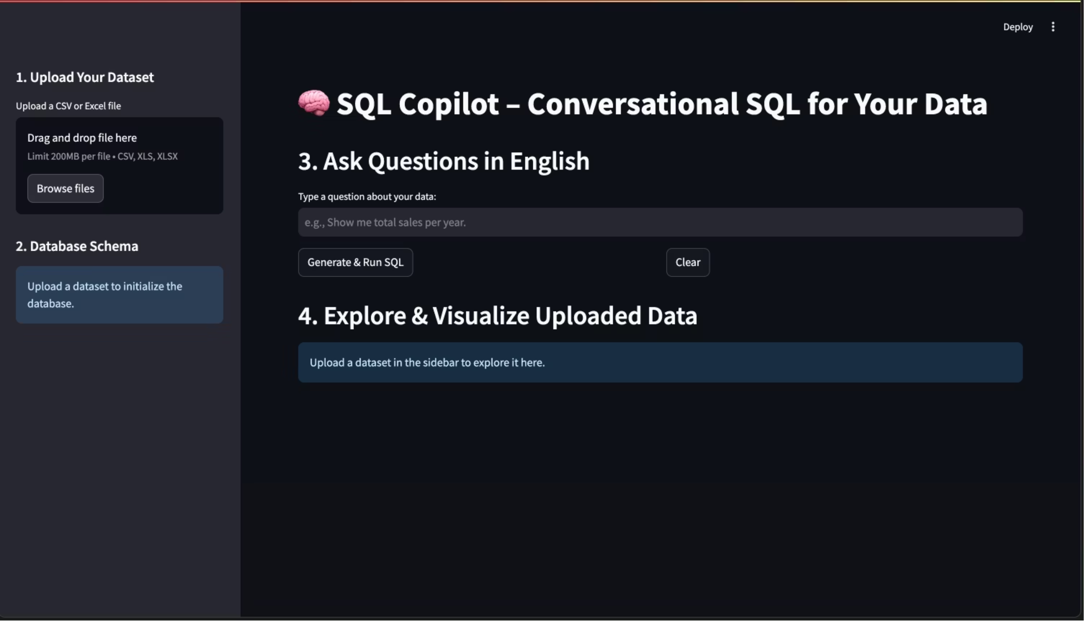
System Interface in Action
How It Looks

Slide 6

Experimental Setup: Streamlit Application Workflow
01
Data Upload
Users upload CSV files containing fossil fuel energy data
02
Natural Language Query
Enter questions in plain English about the dataset
03
SQL Execution
Gemini generates and executes validated SELECT queries
04
Visual Results
Interactive tables and charts display query results
Evaluation Methodology
Query correctness assessed using Execution Success (does the SQL run) and Result-Set Accuracy (do the results match the ground-truth output), rather than exact string-level SQL matching.

Slide 7
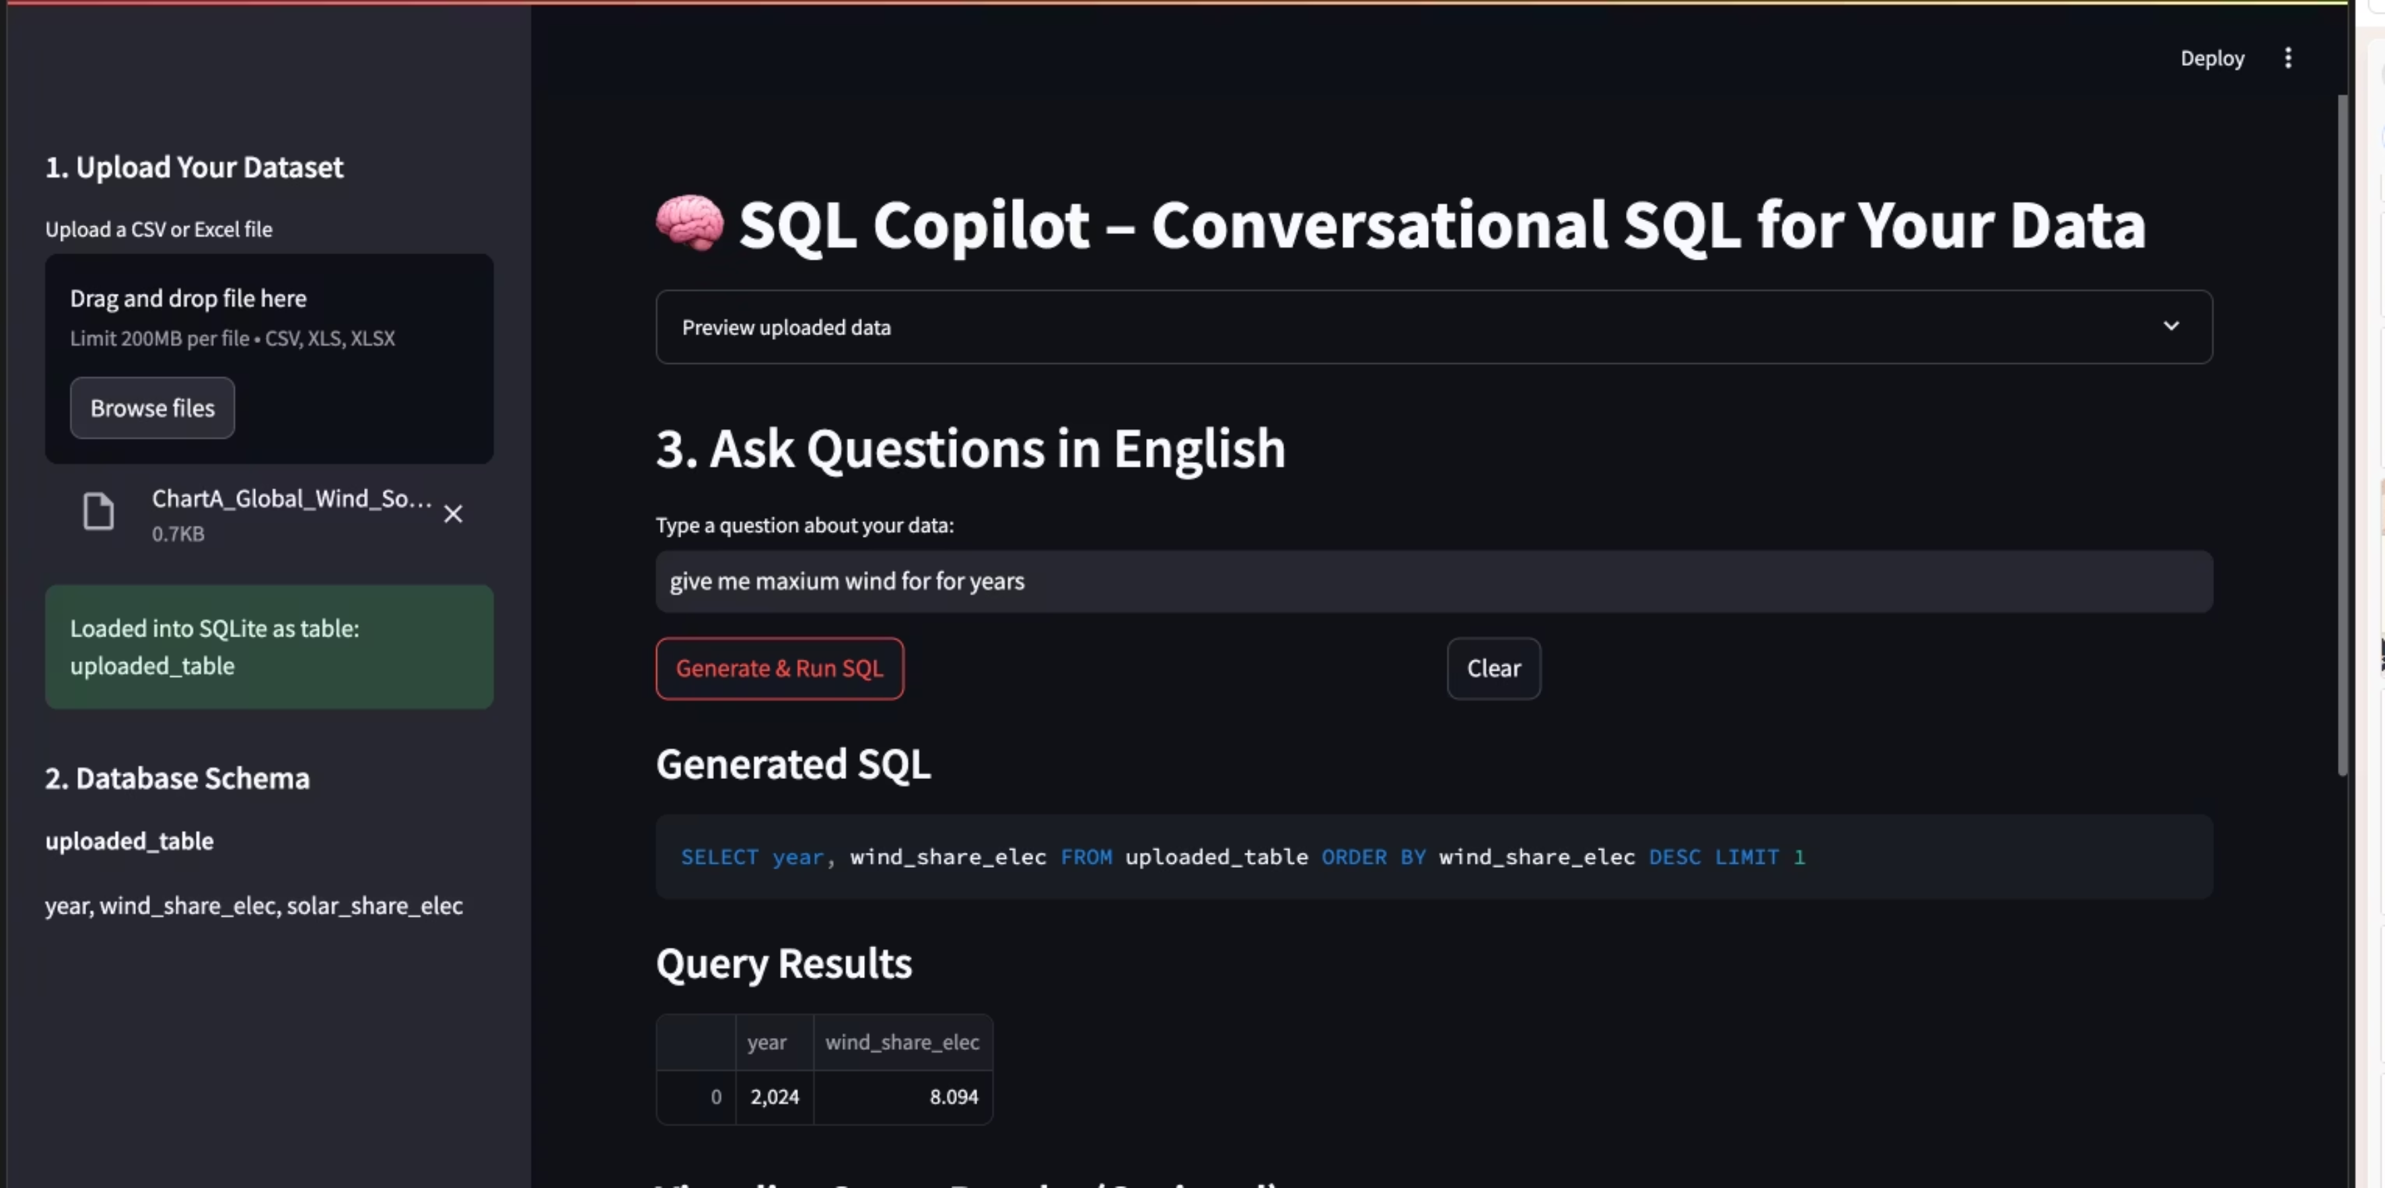
Streamlit Application Workflow
The Complete Running Setup
This screenshot demonstrates the complete end-to-end workflow of the SQL Copilot application, showing all key components in action: dataset upload, schema integration, natural language query input, SQL generation, and interactive results display.

Slide 8

Prompt Design & Safety Guardrails
Model Configuration
Validation Layer
Fixed LLM Configuration
We treat Gemini 2.5 Flash as a frozen API model – there is no fine-tuning or training, which avoids overfitting to our small NL→SQL benchmark and keeps behavior stable across datasets.
Schema-Guided Prompting
Before each query, the backend calls SQLite PRAGMA commands to extract the table and column names. This schema string is injected into the Gemini prompt so generated SQL is grounded in the actual table structure instead of hallucinated columns.
Synonym Normalization
A lightweight synonym map rewrites user phrases (e.g., “emissions” → co2_emissions) before prompting. This reduces ambiguity and helps the model consistently map natural-language terms to the correct columns.
Static Safety FilterRegex-based guard that blocks any SQL containing forbidden keywords (DROP, DELETE, UPDATE, etc.) before it ever reaches SQLite.
Execution Validation (ExecSucc)A query is counted as successful only if it runs on SQLite without errors; this Execution Success rate is one of our main evaluation metrics.

Slide 9

Results & Performance Metrics
100%
90%
0.82s
Execution Success Rate
SQL Accuracy
Average Latency
Semantic match with ground truth
End-to-end query generation time
Queries executed without errors
Key Insights
High accuracy on temporal queries: Year-based filtering and aggregations perform exceptionally well
Strong country-specific analysis: Geographic queries demonstrate robust semantic understanding
Complex aggregations: Successfully handles AVG, SUM, MAX calculations with appropriate GROUP BY clauses

Slide 10
Ablation Study: Design Choices Impact
To quantify the effect of our design choices, we ran a small ablation study. It compares variants with and without schema awareness, synonym normalization, and safety checks. Schema guidance provides the largest improvement in execution and result quality, while synonyms offer a smaller but consistent boost. Safety checks do not directly change ExecSucc but ensure that all generated queries are valid and bounded.
Variant
ExecSucc
ResultAcc
Notes
No schema, no synonyms
0.80
0.62
Basic prompting; several queries misaligned
Schema-aware prompt
0.90
0.78
Schema guidance improves table/column grounding
Schema + synonyms (final)
1.00
0.90
Best performance: all queries execute successfully

Slide 11
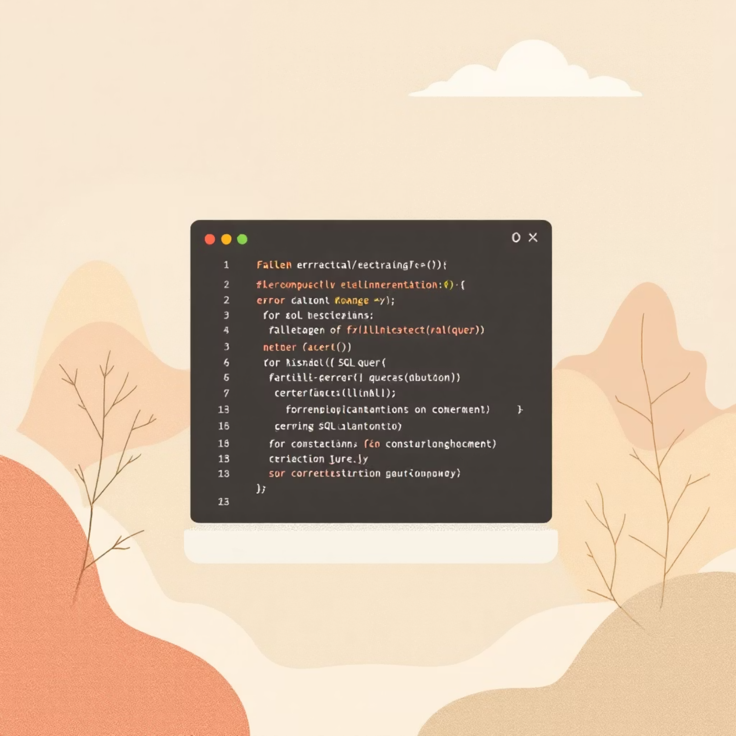

Error Analysis & System Limitations
Common Failure Patterns
Multi-Step Reasoning Failures
The model performs well on simple aggregations, but breaks on queries that need temporal or sequential reasoning (e.g., “years where fossil share increased every year”), where it fails to encode the monotonic trend correctly.
Single-Table Schema Limitation
The current system only supports a single table and cannot answer questions that require joins or relationships across multiple tables, which limits how complex the queries can be.
Mitigation Strategies: Add few-shot examples and better prompt templates for temporal and multi-step reasoning.
Extend the system to support multi-table schemas and join reasoning in future work.

Slide 12
Summary & Future Directions
Key Achievements
Democratized Data Access
Reliable NL→SQL Performance
Production-Ready Safety
Non-technical users can now query complex energy datasets using natural language
Achieved 100% execution success and 90% result accuracy on a 50-question benchmark, with about 0.8s end-to-end latency per query.
Read-only query restrictions and validation layers ensure secure deployment
Lessons Learned
Explicit schema-aware prompting plus a read-only safety wrapper (forbidden-keyword filter + automatic LIMIT) were essential to keep Gemini from hallucinating columns and to reach 100% execution success and 90% result accuracy on our NL→SQL benchmark.
Future Enhancements
Multi-table JOIN support: Expand to complex relational schemas
Multilingual capabilities: Support non-English natural language inputs
Query optimization: Performance tuning for large-scale datasets

Slide 13
Conclusion
Key Takeaways
Impact & Applications
Our natural language to SQL translation system demonstrates the viability of LLM-powered database interfaces, achieving strong performance on standard queries while identifying clear paths for improvement.
This work contributes to the growing field of natural language data interfaces and provides a foundation for future research in semantic query understanding and generation.
By democratizing database access, this technology has the potential to transform how organizations leverage their data assets, enabling broader participation in data-driven decision making.

